Slide 1
Design Specification
By: Team 4D

Slide 2
Team 4D - Car Website
The aim of our website is to give sellers a market to sell their cars for the right prices and so the users can interact with such sellers and find their best budget car or dream car.
The user can be a buyer if they choose to. But to be a seller the user must create an account. The user can search for cars and use the filter bar to filter for specific cars. The user can also upload and sell cars. The user can also post reviews on specific cars. If a user wants to buy a car, they can message the seller, however they have to have an account before the user can proceed as such.
Each car has its own specific details and reviews. Each car can also be specified by brand, quality of use and more. This will provide more details for users to carefully pick cars.

Slide 3
Requirements
User registration and authentication (users should be able to create an account and log in to the platform)
Vehicle listings and search (users should be able to search for vehicles based on various criteria, such as make, model, year, price range, location, etc. They should be able to sort based on various criteria too. Sellers should be able to list their vehicles for sale, including uploading photos and providing detailed descriptions)
Detailed vehicle information and photos (sellers should be able to upload photos and post the required details about the car)
Contact and communication between buyers and sellers ( buyers should be able to message the sellers for further details)

Slide 4
Persona One

Slide 5
Persona Two

Slide 6
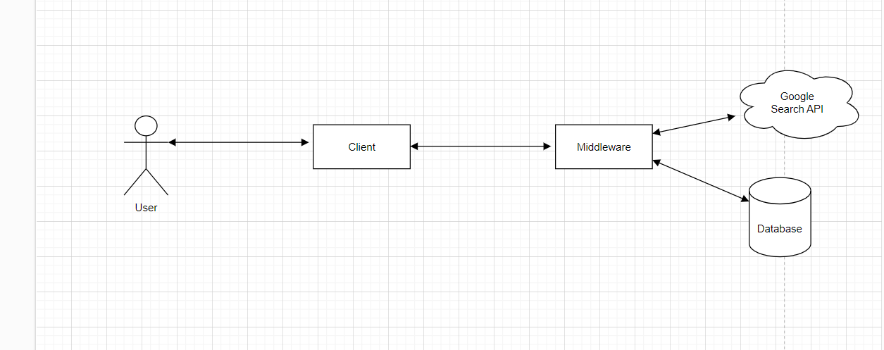
System Architecture

Slide 7
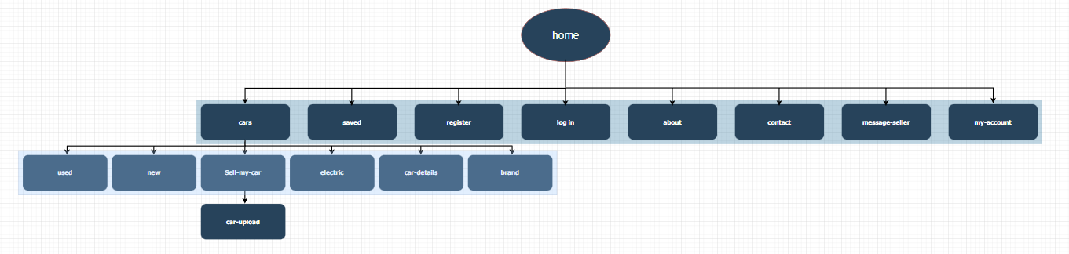
Site Map

Slide 8
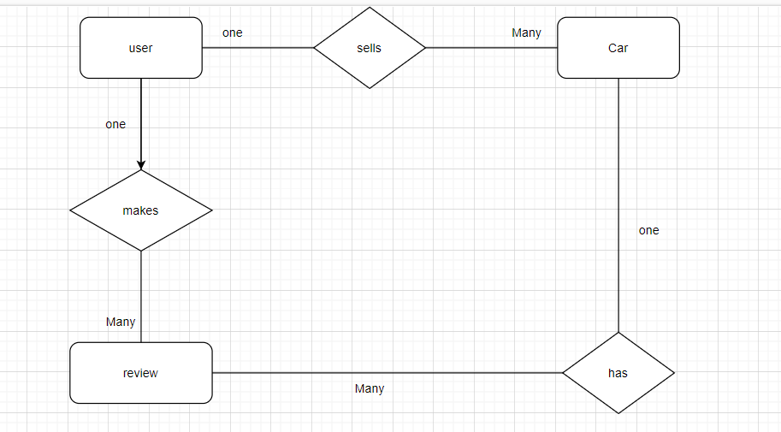
ER diagram

Slide 9
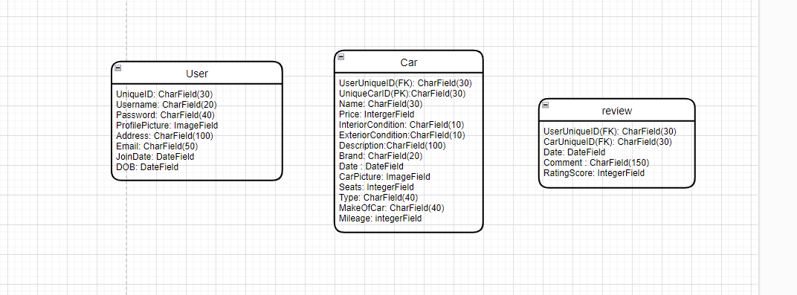
ER Diagram entity attributes and fields

Slide 10
URLS
-/Home
-/Home/Cars
-/Home/Cars/New
- /Home/Cars/Used
-/Home/Cars/Sell-My-Car
-/Home/Sell-Cars/Car-Upload
-/Home/Electric
-/Home/Cars/Car-Details
-/Home/Cars/Car-Brand
-/Home/Log-In
-/Home/Register
-/Home/Contact-Us

Slide 11
URLS continued
-/Home/About-Us
-/Home/Saved
-/Home/MyAccount
-/Home/Message-Seller

Slide 12
Wireframes

